Slide 1
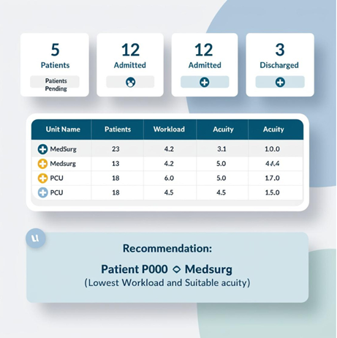

AI-PredictFlow
Optimizing Patient Flow and Resource Allocation
"Using AI to streamline patient flow and resource management in hospitals."
Key Features:
- Predicts patient flow and recommends optimal unit placement.
- Streamlines staff allocation and resource usage.
- Reduces delays and improves patient outcomes.
Team Members
- Salud Lopez
GitHub Repository: https://github.com/ksu-hmi/AI-PredictFlow-Optimizing-Patient-Flow-and-Resource-Allocation/tree/main

